Slide 1
Flash Carma
by Adrian West, Brandon Sitz, Joseph Ramos-Garcia, and Josh Moore

Slide 2
Overview
What is Flash Carma?
Features and Pages
Technologies Used
Risks and Solutions
Summary
Questions and Closing

Slide 3
What is Flash Carma?
Traditional Flash Cards
Time consuming to create
Materials add unnecessary cost
Bland
Flash Carma
Utilizes digital flashcards
No cost for additional cards
Entertaining features

Slide 4
Features
Digital Flash Cards
Unlimited number of cards
Unlimited number of study decks
Score
Points for correct answers
Cumulative score
Correct answer streak
Fire symbol
Correct answer counter
Notes:
The user can create an unlimited number of flash cards.
The user can separate their flash cards by category into multiple “study decks”, which they can also create an unlimited number of.
While the user studies any one of their study decks, they are awarded points during that “study session”. These points are displayed to the user at the end of the session to show the user’s proficiency with that deck and then added to a cumulative score displayed on the home screen.
During a study session, if the user gives two or more correct answers in a row, a symbol resembling a fire will appear at the top of the screen next to the flash card number- which, at any given time, shows the user what number flash card they are on out of the total number of flash cards in the study deck- to indicate the user has started a correct answer streak. Within the fire will be a counter showing how many correct answers have been given during that streak. As the streak continues, the counter will increase, and the icon will slightly increase in size.

Slide 5
Login page and Homepage
Login / sign up options
Forgot password option
Redirects to Homepage
Homepage
Study streak
Study score
Link to study decks list
Link to settings
Recent decks

Slide 6
Settings Page
Profile settings
Change password/username
Website settings
Theme swap
Layout change
Notes:
Change username/password
light / dark mode
Possible swap between grid and list formats

Slide 7
Study Deck Page
View all study decks in a grid layout
Create new
Edit existing
Study a deck
Delete a deck
Search for a deck

Slide 8
Editing Decks
Deck name
Display Flashcard
Edit text on both sides
Swap through
Add new
Save and quit
Delete card

Slide 9
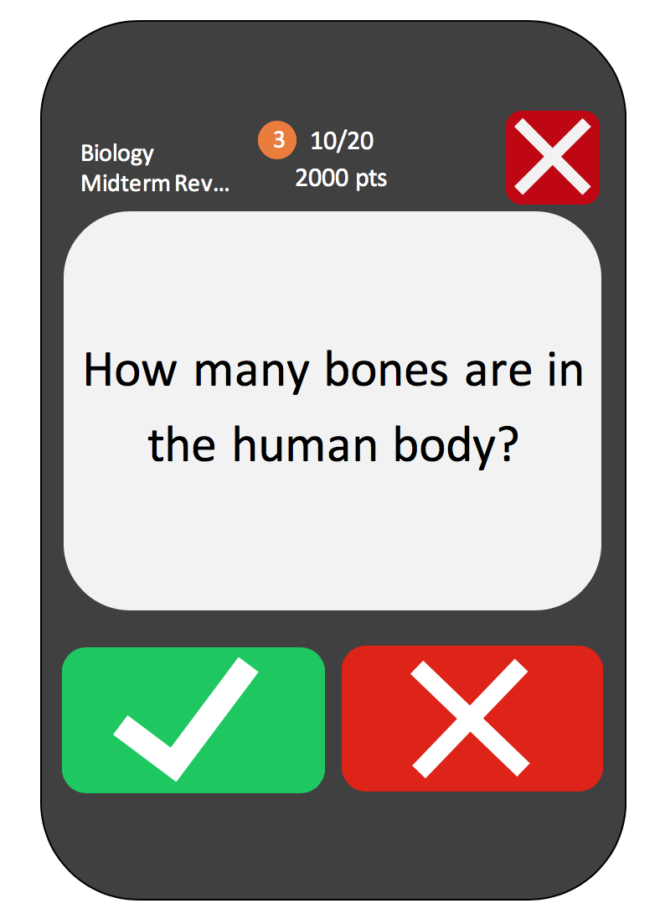
Study Session
Deck Name
Score for session & Streak
Card number
Display Flashcard
Swap sides
Correct/Incorrect answer
Cancel session

Slide 10
Technologies Used: Firebase
Realtime database storing information stored in JSON
User Authentication
User information
Flashcard data
Website hosting

Slide 11
Other Technologies Used
React
Libraries for better use of components
Chakra UI
Tailwind CSS
Node JS
Framework
Express

Slide 12
Risks and Solutions
Firebase
Unpredictable pricing
Spark plan is free
Blaze plan is “pay as you go”
Storing data
Stored as JSON file
Firebase has features that don’t exist elsewhere

Slide 13
Risks and Solutions
Migrate to a server on linode
User authentication is more difficult
Migrate to a SQL database
mySQL or MariaDB
CSS Animations
Streak icon growing in size
Flash card animation

Slide 14
Summary
What is Flash Carma?
Features and Pages
Technologies Used
Risks and Solutions

Slide 15
Closing
Questions
Comments
Concerns
Thank you for your time!

